Slide 1
Paper reading currently
Wipf, David. "Marginalization is not marginal: no bad VAE local minima when learning optimal sparse representations." International Conference on Machine Learning. PMLR, 2023.
Saying “VAE, that is linear and have full-covariance matrix, is sufficient to recover the optimal latent representation”

Slide 2
Paper reading currently
I have read it before
but I simply took it to “The expressive power of the encoder is more important than the decoder”
It is a (relatively) recent paper, and it is similar to my perspective
So I am reading it closely to get some intuition for new idea
I am looking at everything from background to proof

Slide 3
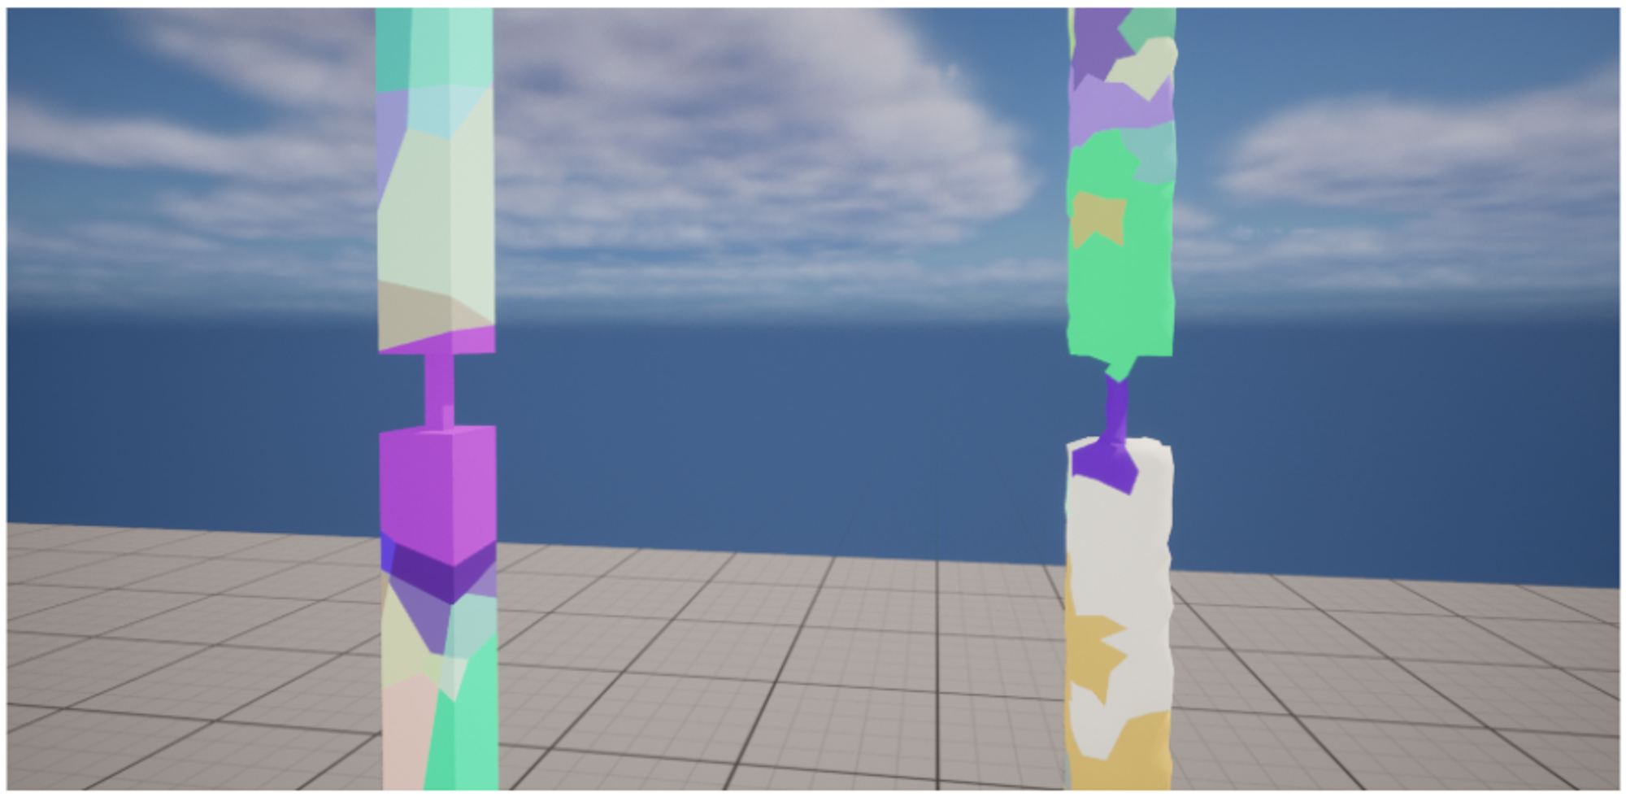
Side Idea
Fracturing mesh (in Capstone Design 2023)

Slide 4
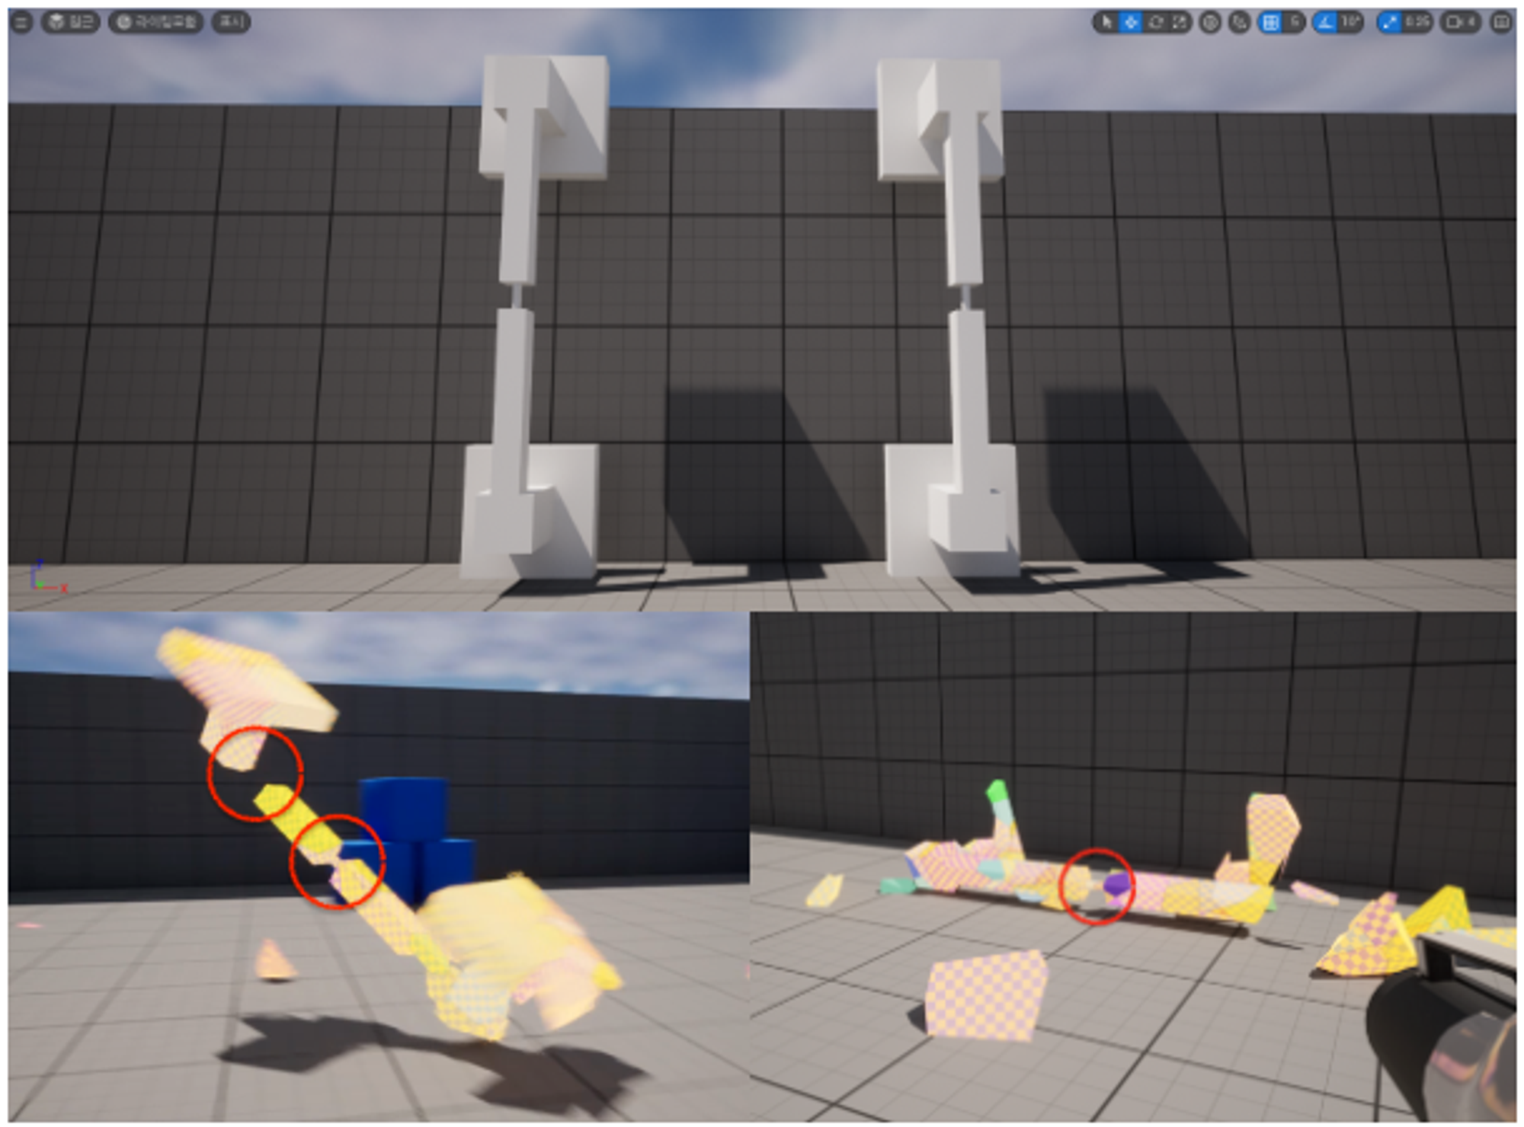
The problem
The commonly used method is heuristic clustering
So there are quality limitations

Slide 5
The method
With the aid of deep clustering model,
more realistic mesh breaking is achieved
It is not outstanding
But the approach is odd (or unique, put it nicely) and easy to visualize
So I think it would be fine as a two-page poster

Slide 6
The limitations (need to be addressed)
It is just a simple clustering model
Possible solutions:
The shape of the break changes depending on the size and direction of the force
It would require a lot of domain knowledge, to create dataset
Or at least break differently each time by a generative model
The model capacity must be large, to be a generative model

Slide 7
The limitations (need to be addressed)
Before clustering, I need to divide it into small pieces
During Capstone, the mesh was converted to a tetrahedral structure, but the quality was poor due to conversion error
Solution: Create a 3D Voronoi diagram
I cannot find any good code, so I have to study it myself and code…
The surface quality is poor

Slide 8
The limitations (need to be addressed)
Even pieces that did not fit together formed the same cluster
During Capstone, I just did post-processing (it is very easy but slow)
Solution: a loss for distance on mesh or some kind of meeting metric?
Even though they are separated (in space), they can be classified into the same cluster; this is very bad!

Slide 9
The limitations (need to be addressed)
Huang, Yuhang, and Takashi Kanai. "DeepFracture: A Generative Approach for Predicting Brittle Fractures." arXiv preprint arXiv:2310.13344 (2023).
The biggest problem is that the paper with good performance came out last year
However, it is very large, complex, and contains a lot of domain knowledge
My method is simple and strange, but its strength is it is end-to-end and works quite well

Slide 10
Conc.
Would it be worth writing it to paper (without completely replacing it)?
It seems vague, so I put it aside for now
Studying VAE and Mamba currently
In particular, Mamba is very interesting architecture and gives me a lot of ideas to apply to computer vision
However, I am scared to give it my all
because it is one of the most popular topic recently,
and it is totally different from the topics I have studied before

Slide 11
VAE Claim
Recent research on VAE:
Shekhovtsov, Alexander, Dmitrij Schlesinger, and Boris Flach. "VAE approximation error: ELBO and exponential families." arXiv preprint arXiv:2102.09310 (2021).
The encoding distribution of VAE lacks capacity!
Even in the simple toy example, VAE fails to restore the original dist.
And this is largely the encoder’s fault!
Wipf, David. "Marginalization is not marginal: no bad VAE local minima when learning optimal sparse representations." International Conference on Machine Learning. PMLR, 2023.
VAE can restore the original distribution with
only a strong (i.e. full covariance) encoder and a very weak (i.e. linear) decoder!
We also show two theorem:
1. Increasing the decoder capacity does not improve performance at all
2. Limiting the encoder to conventional setting (i.e. diagonal covariance) diminishes its advantages and makes it identical to an autoencoder

Slide 12
VAE Claim
It is okay for the decoder to have a small capacity
Rather, it is very surplus now
But the encoder is very weak in conventional setting
We are only using diagonal covariance!!
Why cannot a more complex decoder solve this?
One can change an independent RV to a dependent RV by passing a function
Does having off-diagonal covariance mean more?

Slide 13
VAE Claim
I guessed, it is important to create a bias
that allows the decoder to interpret well the area
that were not revealed in the distribution inferenced by the encoder
(but could occur in sampling!)
However, if the encoder is problematic,
the distribution is wrong in the first place

Slide 14
VAE Claim
Clue:
LDM/Stable Diffusion generate well in the latent space of AE/VAE
Latent Diffusion Model employed the encoder and decoder of regularized AE as is
and changed only the latent distribution by diffusion to achieve SOTA
It was not even end-to-end, it was pretrained
They just changed the distribution; the decoder is still the same!!!

Slide 15
VAE Claim
Make sufficiently complex latent distribution
Possible Solution:
1. Strengthens the encoder
Is something more possible than using full covariance?
2. Enhance sampling (like LDM)
Assuming the decoder is just fine!!!

